Slide 1
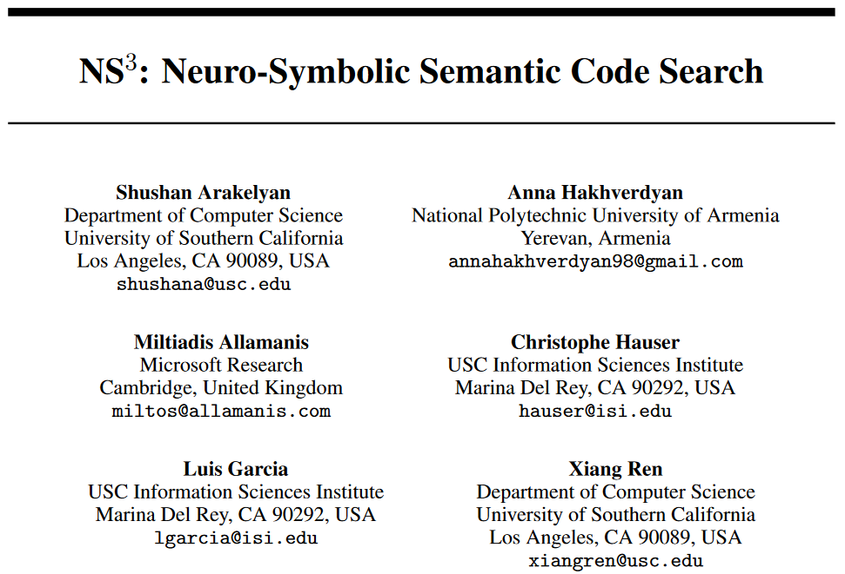
ICLR 2022 Workshop DL4C Spotlight & NeurIPS 2022 Poster (?)

Slide 2
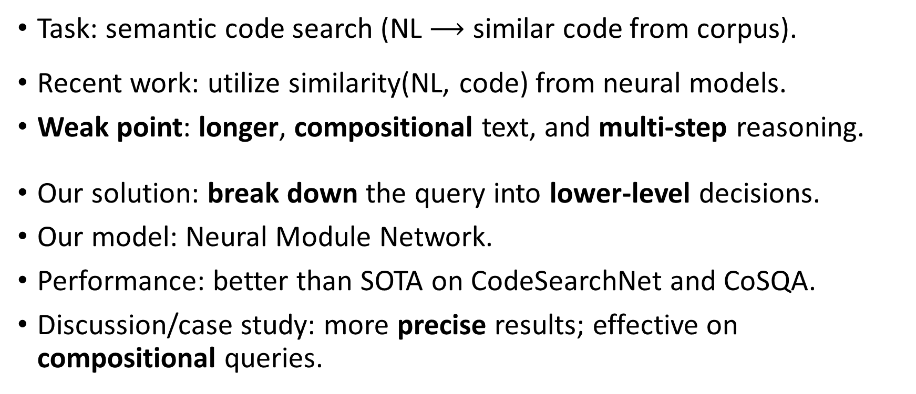
Abstract
Task: semantic code search (NL $⟶$ similar code from corpus).
Recent work: utilize similarity(NL, code) from neural models.
Weak point: longer, compositional text, and multi-step reasoning.
Our solution: break down the query into lower-level decisions.
Our model: Neural Module Network.
Performance: better than SOTA on CodeSearchNet and CoSQA.
Discussion/case study: more precise results; effective on compositional queries.

Slide 3
Problem
In semantic code search, current neural approach cannot deal with queries with compositional language queries.
Encoding longer text into a dense vector is itself an open problem.
Because NNs are not believed to be extracting systematic rules from data.
This problem has to be solved:
It effects the performance
It drastically reduces a model's value for the users.

Slide 4
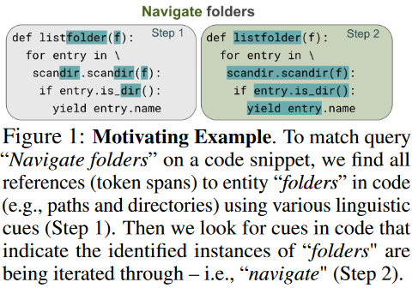
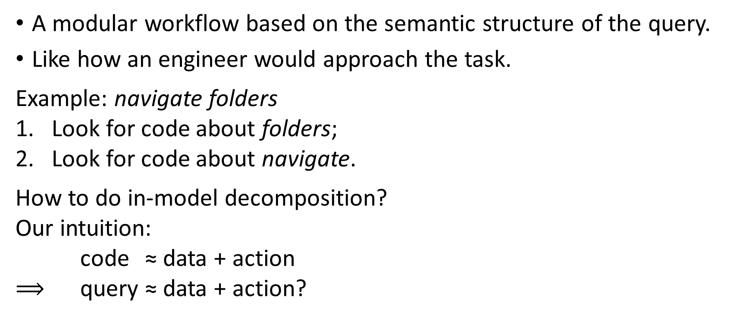
NS³ - Brief
A modular workflow based on the semantic structure of the query.
Like how an engineer would approach the task.
Example: navigate folders
Look for code about folders;
Look for code about navigate.
How to do in-model decomposition?
Our intuition:
code ≈ data + action
$⟹$ query ≈ data + action?

Slide 5
NS³
Use semantic parse of the query to get individual subtasks of matching the data entities and actions, and their relationship;
Match individual data entities and actions;
Combine results from subtasks to get the final answer.
Advantages
Compositionality is captured by semantic parse.
Model does not need to process long NL texts.
Applying the neural modules in a succession can potentially mimic human staged reasoning.

Slide 6
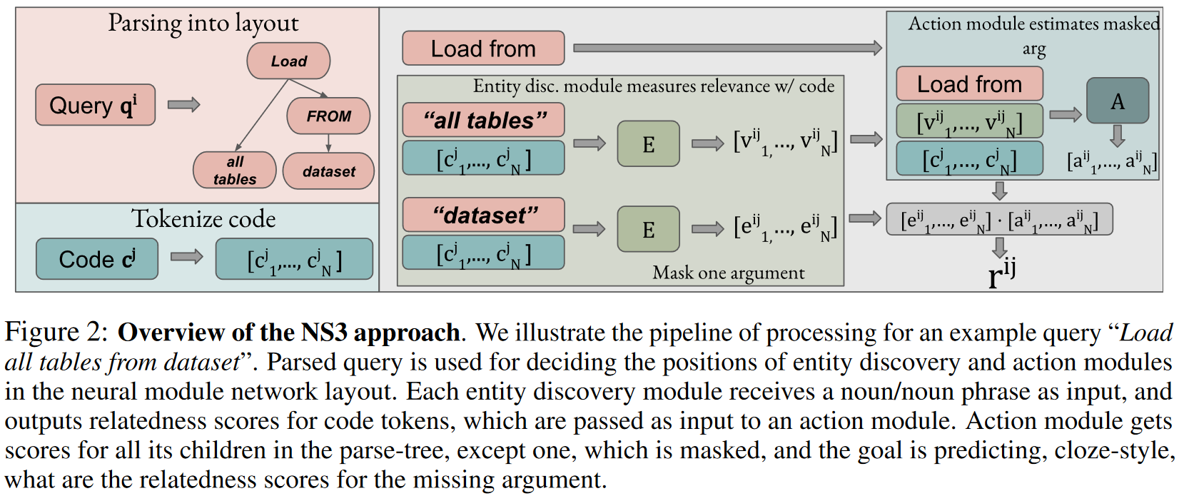
NS³

Slide 7
NS³ - Overview
Entity discovery module (E)
relatedness(code token, entity).
Action module (A)
relatedness(code token, unseen argument | action, all other arguments).
By leaving one argument out, we can measure how well the code matches that part of the query.
Action module's input contains other modules' output, nested as the semantic parse layout.

Slide 8
NS³ - Module Network Layout
Parsing: pair the query with a simple semantic parse that looks like DO WHAT [(to/from/in/...) WHAT, WHEN, WHERE, HOW, etc].
Then the query can be broken down into shorter semantic phrases using the roles of different parts of speech.
Use a Combinatory categorial Grammar-based (CCG) semantic parser to infer the semantic parse for each query.

Slide 9
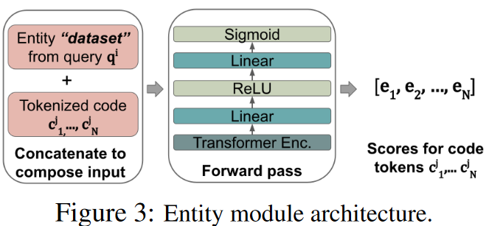
NS³ - Entity Discovery Module
Calculate relatedness score between the entity and each code token.
There is no natural supervision signal for this module, so we create noisy supervision for this module:
Keyword matching: whether a code token is an exact match / substring / superstring / synonym of some token(s) in the input string. Synonyms are manually collected, so only common ones are included.
Static analyzer: whether a code token's (statically inferred) type is the same as some token(s) in the input string.

Slide 10
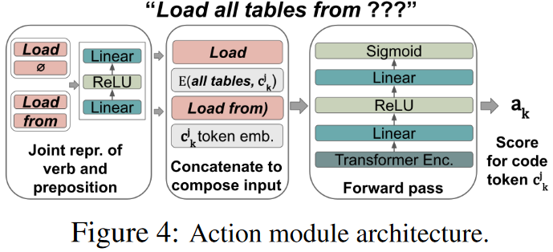
NS³ - Action Module
Last data entity argument is always masked.
During pre-training, the output score of the entity discovery module is used as supervision.

Slide 11
NS³ - Model Prediction
The final score is the dot product of the outputs of the action and the entity discovery modules.
If there is more than one action in the query, take the product of their scores as the final score.

Slide 12
NS³ - Pre-training and Joint Fine-tuning
The training is two-phased: first pre-train the model with supervision as we have specified, and then train the model in an end-to-end way.
Batching is hard for our model, so for a given query, our model only re-rank the top-K highest ranked code snippets from some baseline model.
Our model is used in a re-ranking setup, which is common in IR, known as L2 ranking. We use the probabilities from our model as ranking scores.

Slide 13
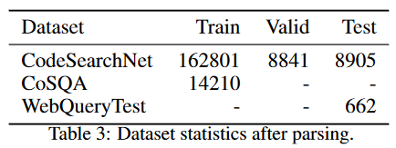
Experiment Settings - Dataset
CodeSearchNet Python, CoSQA/WebQueryTest.
Unparsable examples are excluded.
CSN remains 40%, CoSQA 70%.
We believe the difference is because CSN is collected from docstrings.
We use this part of dataset for fine-tuning for baselines.
To test NS³'s sample efficiency, even smaller subsets of CSN, which contain 5K and 10K examples respectively, are also used to fine-tune all models.

Slide 14
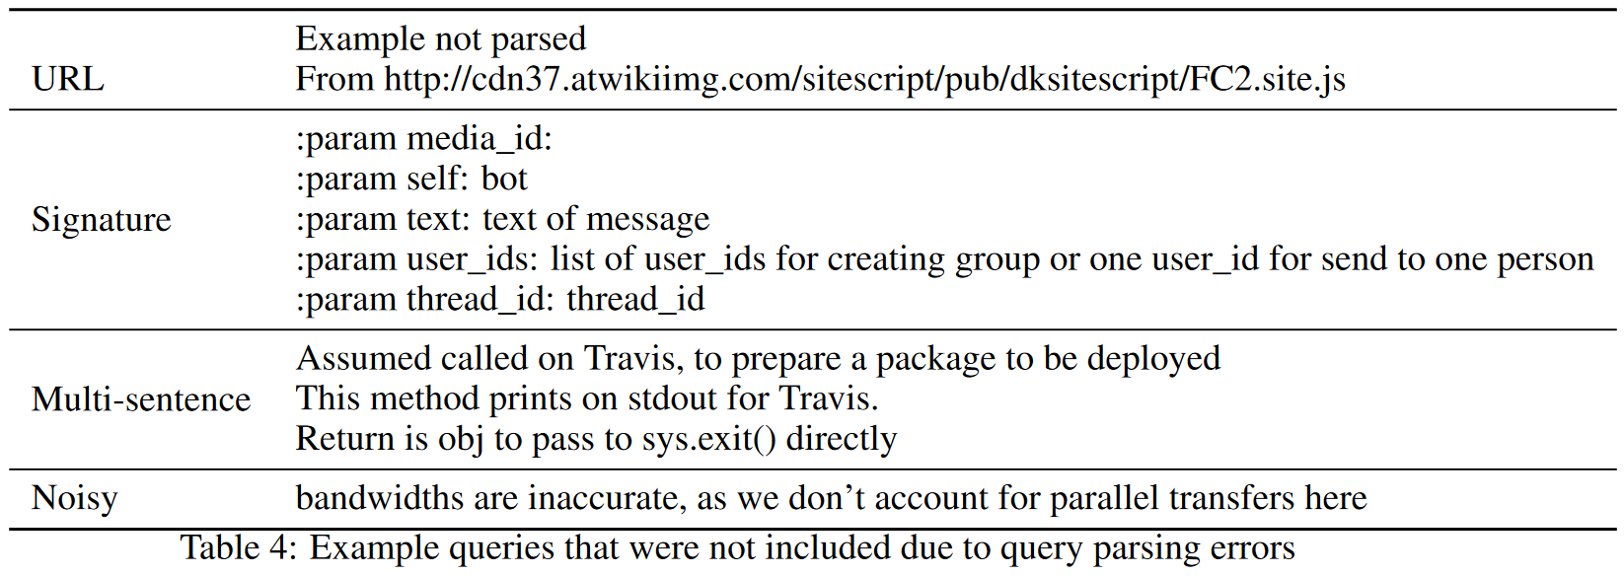
Example queries that cannot parse

Slide 15
Experiment Settings - Query Parser
Built on top of NLTK Python package.
Build a vocabulary of predicates for common action verbs and entity nouns.
Use a "catch-all" rule to parse sentences with less-common words.
Remove preceding question words, e.g. How to; punctuations; specific words and phrases, e.g. Python.
For noun-only phrase in CSN, append a load verb to make a valid sentence. Note that this can create noisy examples, e.g. load wrapper.

Slide 16
Experiment Settings - Models
Use two-step evaluation:
Obtain CodeBERT's output against 999 distractors.
Use NS³ to re-rank the top 10 predictions of CodeBERT.
Because NS3 cannot pre-process all the code snippets.
Two-step evaluation is a common practice.
Baselines:
GraphCodeBERT is a pre-trained LM.
GraphCodeBERT* is a re-ranking baseline, using the same setup as for NS³.

Slide 17
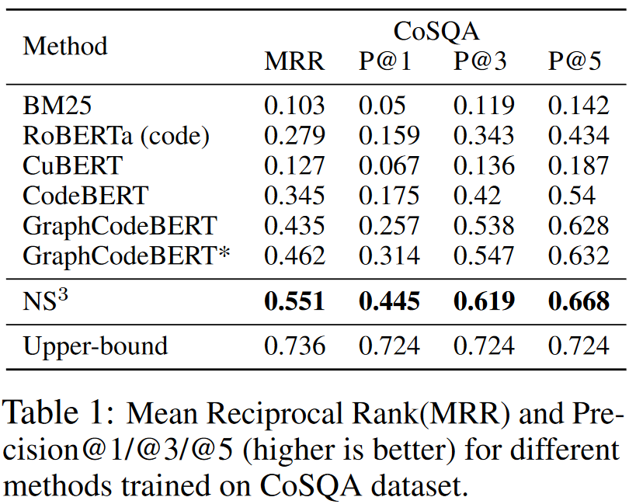
Experimental Results - CoSQA

Slide 18
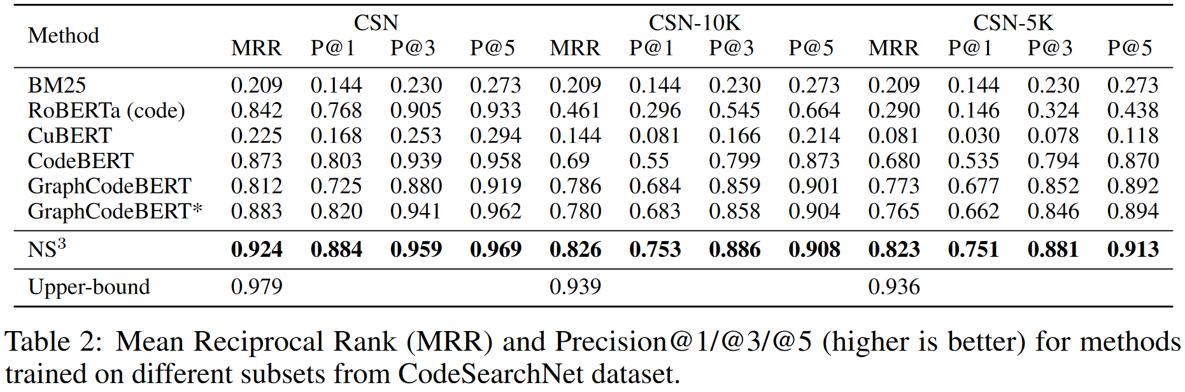
Experimental Results - CSN

Slide 19
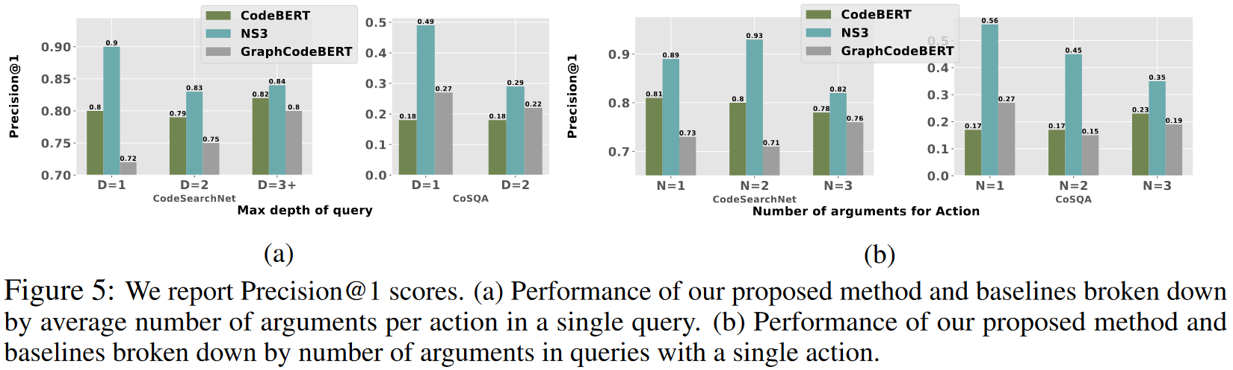
Query Complexity vs Performance

Slide 20
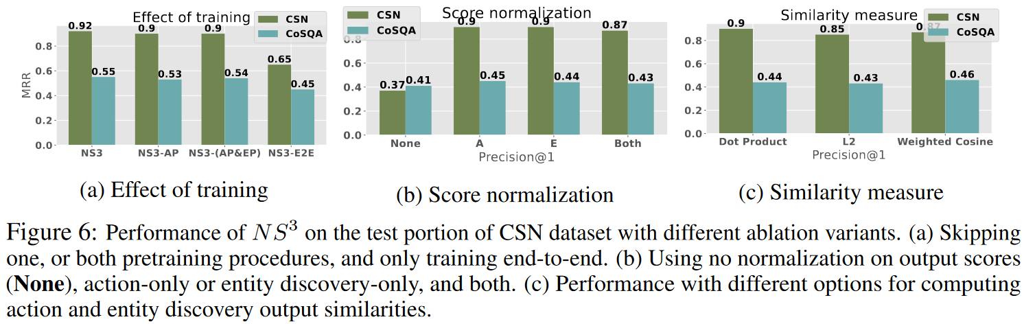
Ablation Studies

Slide 21
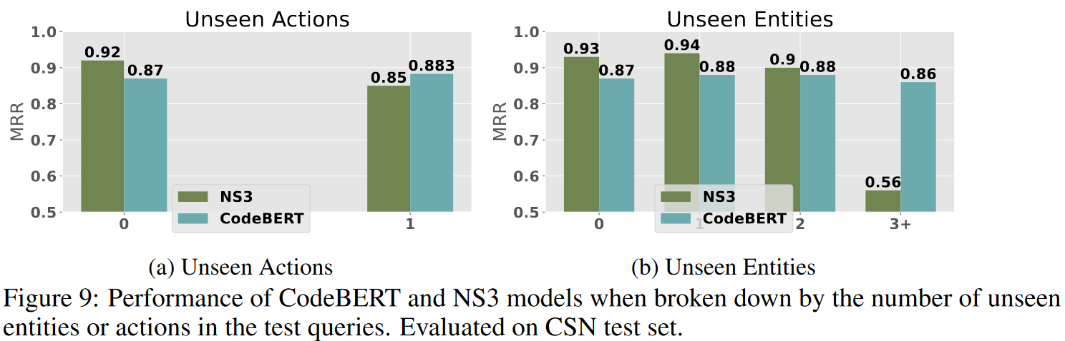
Ablation Studies - Unseen Entities and Actions

Slide 22
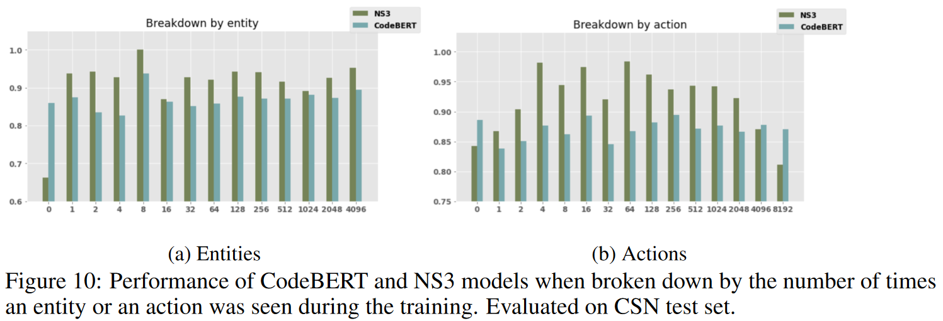
Ablation Studies

Slide 23
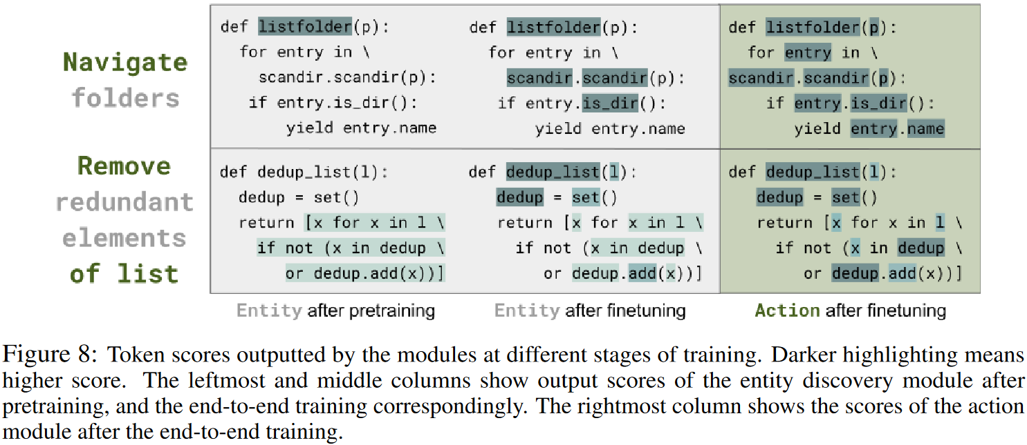
Case Study

Slide 24
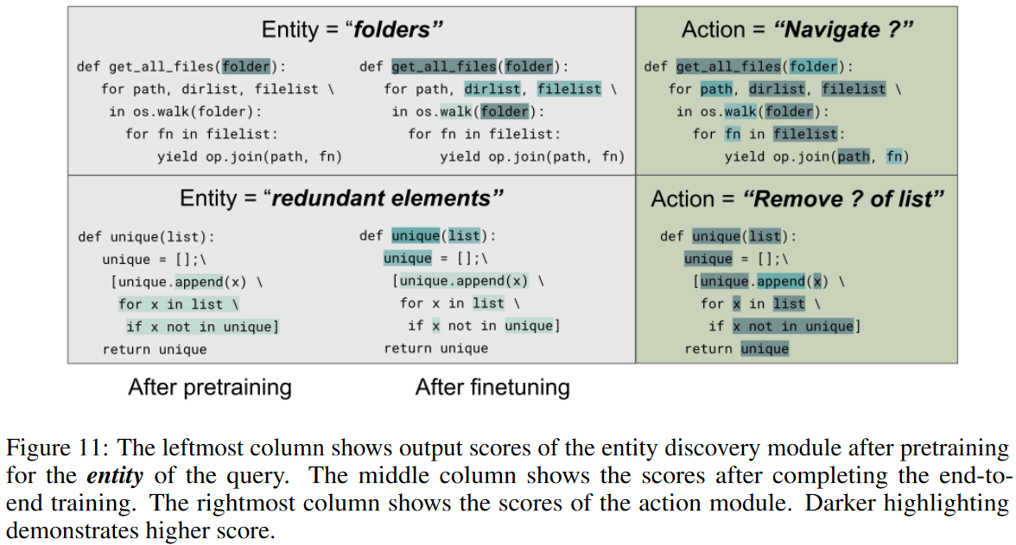
Case Study

Slide 25
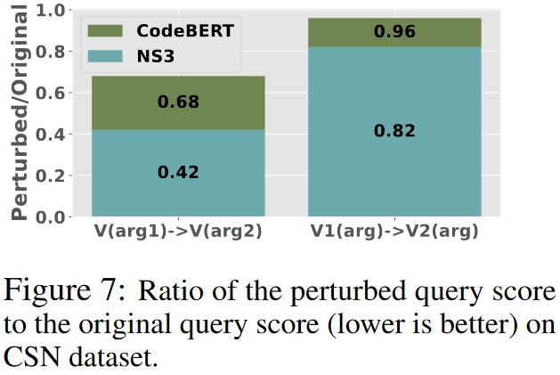
Analysis - Perturbed Query Evaluation
We slightly change the query, and study the change of model performance.
We start from 100 different pairs that both NS³ and CodeBERT predict correctly and contains only a single verb and a single argument.
We generate 20 perturbations for every query in 2 types: change the verb / change the argument.

Slide 26
Conclusion (Contributions)
We propose looking at SCS as a compositional task that requires multi-step reasoning.
Implementation of the compositional paradigm.
We demonstrate that the proposed model provides a large improvement on a number of well-established baseline models.
Additional studies to evaluate the capacity of the proposed model to handle compositional queries.

